Slide 1

Travelling salesman problem
NP-Problem research by Abdoulkader Haidara

Slide 2
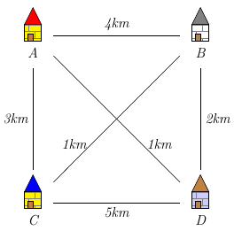
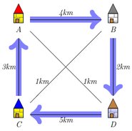
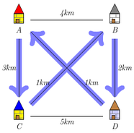
Description, Complexity and some applications
problem
not optimal path
optimal path
Complexity
HAM-CYCLE <= TSP
The problem is NP-complete
Applications
School bus route
In logistics (deliveries, post office etc…)
Biology (genome sequencing for example)

Slide 3
Brute force solution
Complexities
Time: O(n!)
Space: O(n)
7 cities using brute force
This solution becomes unfeasible for even 20 cities.
If a computing a path takes 10^-6second,
for 25 cities the running time exceeds the age of universe(14 billion years).

Slide 4
Dynamic programming solution(Held-karp algorithm)
cities
begins by calculating, for each set of cities
and every city
not contained in S
the shortest one-way path from to that passes through every city in in some order.
Example
= d(1, e)
is the length of
Once S contains three or more cities, the number of paths through S rises quickly, but only a few such paths need to be examined to find the shortest.
<
<
General
The algorithm finishes when
is known for every integer
Complexities
Time: O(n^2*2^n)
Space: O(n*2^n)

Slide 5
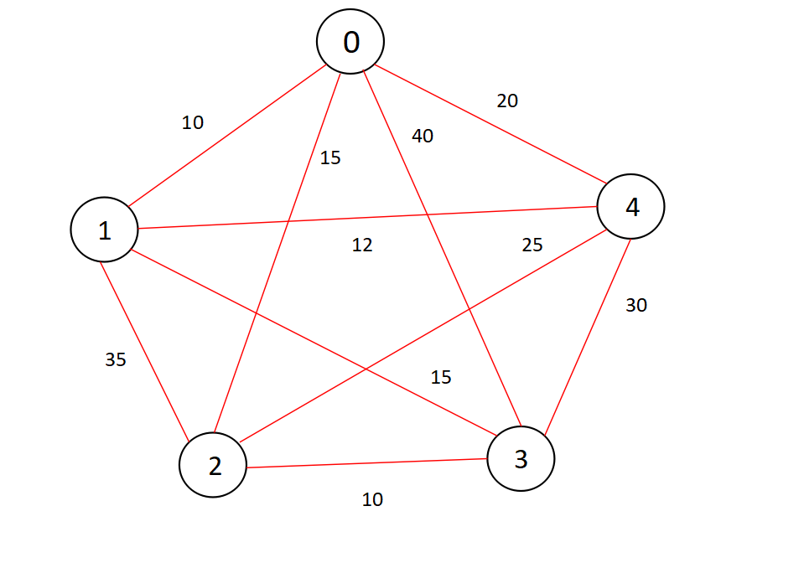
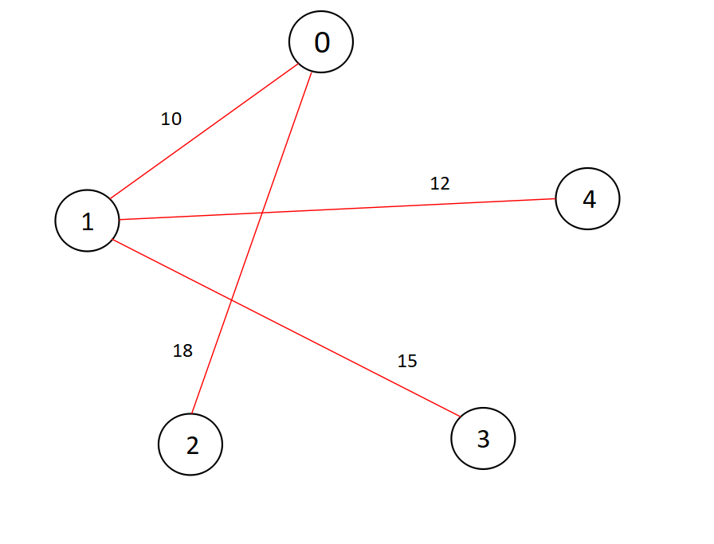
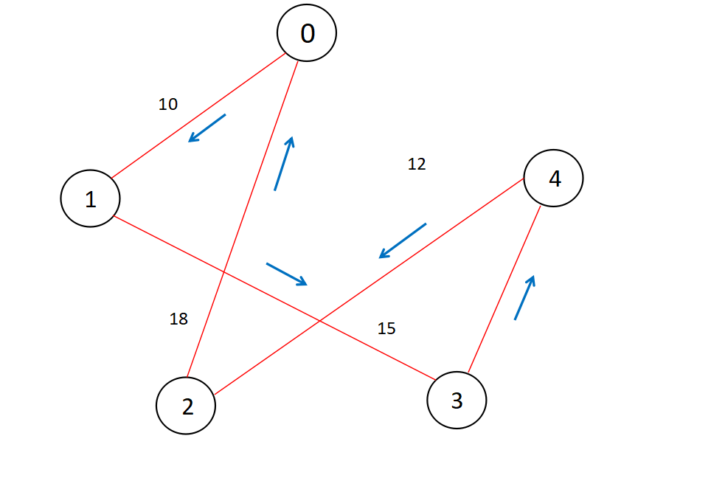
Approximation Solution using minimum spanning tree
Step 1
Minimum spanning tree
Step 2, 3
DFS and preorder walk
Initial graph
Minimum spanning tree: Prim’s Algorithm
Complexities
Time: O(V*V) which is the time complexity for prim’s algorithm
Space: O(V*V)
Nodes connected

Slide 6
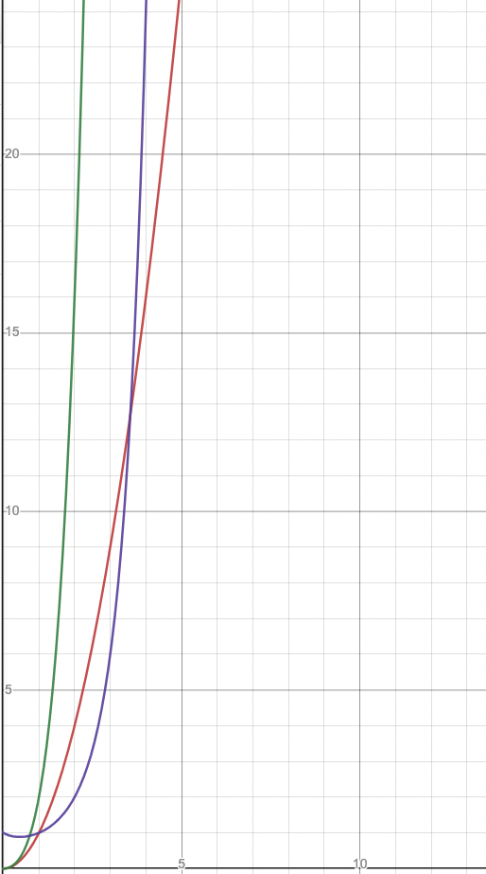
Solution comparisons - Execution time
Approximation solution
Brute force solution
Dynamic programming solution
Example: for n = 12
Brute force: 479001600 operations
Dynamic programming: 589824 operations
Approximation: 144 operations

